Slide 1


Cyberbullying Classification
CS6120 Group 10
Sindhya Balasubramanian, Eileen Chang, Pushyanth Damarapati, Priyanka Padinam

Slide 2

OVERVIEW
Introduction
Method
Results
Evaluation
Conclusion
Future Works

Slide 3
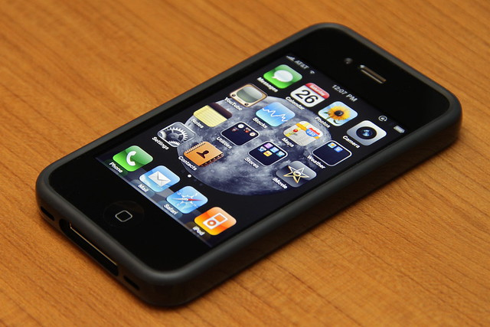
INTRODUCTION
The modern rise of social media users compounded with the recent covid-19 lockdown has led to a concerning increase in cyberbullying cases.
In 2020, UNICEF issued a warning in response to the increased cyberbullying cases caused by social distancing and increased screen-time.
A target of cyberbullying can end up being bullied by many people of various demographics on an extreme scale due to the quick spread of information in web spaces.
The effects of cyberbullying on a person's mental-health can be severe and persist long after the bullying has ceased.
We aim to create a model that will flag harmful tweets and, therefore, protect targets of cyberbullying.

Slide 4
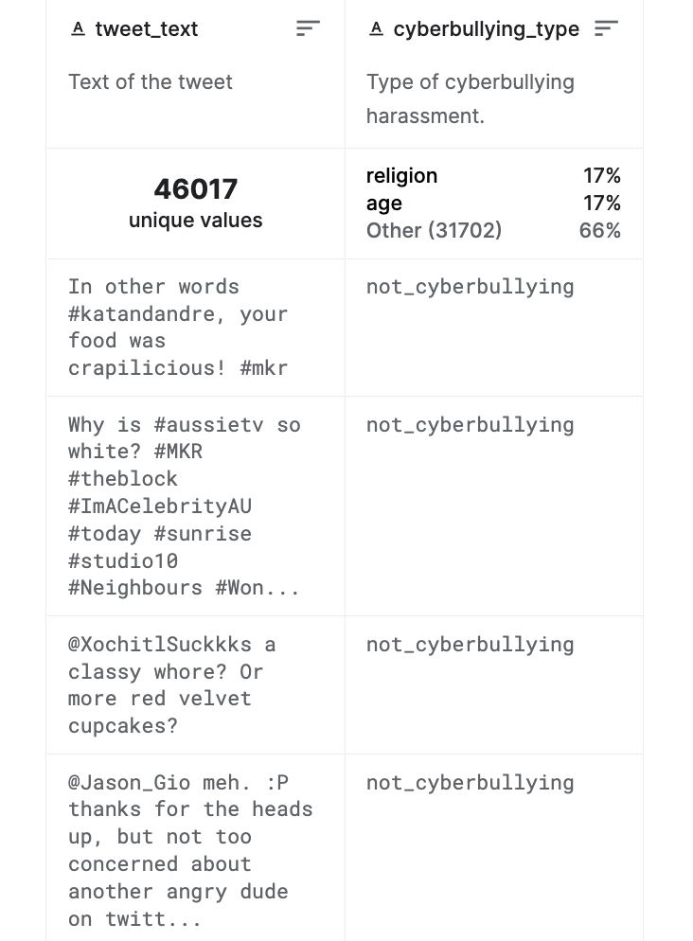
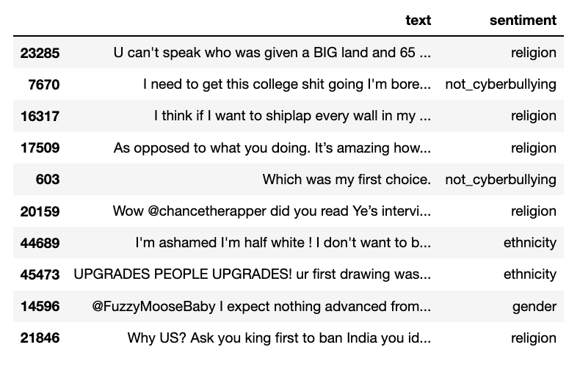
DATASET
Kaggle dataset: Cyberbullying Classification
More than 47,000 tweets labeled according to 6 classes of cyberbullying:
Age
Ethnicity
Gender
Religion
Other type of cyberbullying
Not cyberbullying
Each row of the dataset has a tweet and its class of cyberbullying

Slide 5
METHOD
We implemented two separate classification tasks with our dataset:
Task 1
Two-Class Text Classification as
Cyberbullying vs. Not Cyberbullying
Created a new dataset from the text corpus with the text labeled as either Cyberbullying or Not Cyberbullying.
Task 2
Multi-Class Text Classification as Age, Ethnicity, Gender, Religion, and Other
Created a new data set from the text corpus with the text labeled as the subcategories Age, Ethnicity, Gender, Religion, and Other type of cyberbullying.

Slide 6
METHOD
We used the same methodology for our two classification tasks as follows:
Preprocessing
Models
Naïve Bayes
ANN
CNN
RNN
Clustering

Slide 7
TEXT PREPROCESSING
Removing Punctuations
Eliminating Stop words
Stemming
Lemmatization
Removing numbers and URL tags

Slide 8
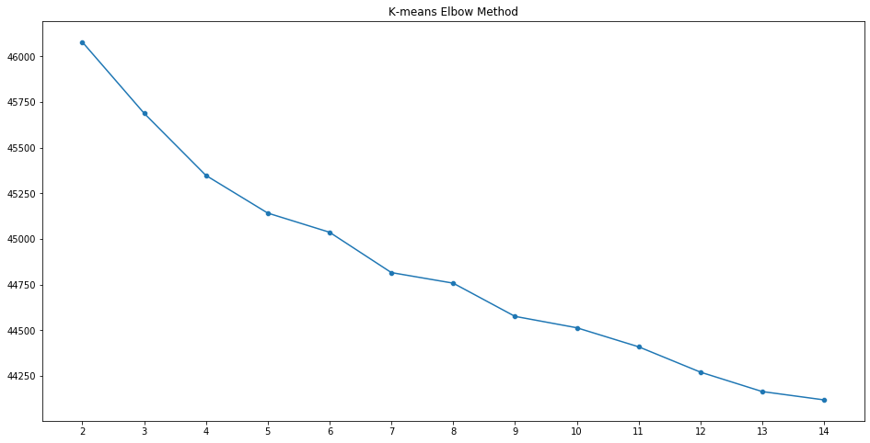
CLUSTERING
Clustering is the task of grouping a set of objects in such a way that objects in the same group (called a cluster) are more similar (in some sense) to each other than to those in other groups.
We processed all the text data into TFIDF vectors and ran K-Means Algorithm on it. We tested the optimal number of clusters using Elbow Method.

Slide 9
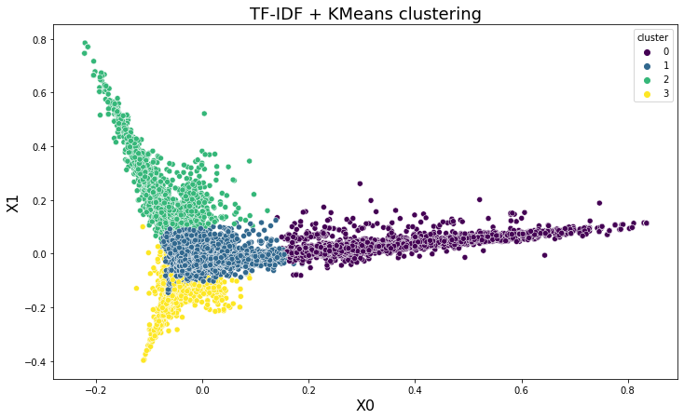
CLUSTERING
Cluster 0
dont,men,think,cyrus,miley,made,like,prison,making,people,funny,make,gay,rape,joke
Cluster 1
year,people,friend,get,would,kid,one,got,middle,like,bully,girl,bullied,high,school
Cluster 2
white,get,shut,nigga,mad,fucking,shit,bitch,rt,tayyoung,obama,as,nigger,dumb,fuck
Cluster 3
get,black,know,right,christian,one,dont,people,woman,im,like,idiot,muslim,rt,mkr

Slide 10
NAÏVE BAYES
We've chosen Naïve Bayes model for its scalability w.r.t both data and the number of predictors.
After pre-processing the data, we employed Naïve Bayes models for both binary classification (cyber-bullying vs not cyberbullying) and multi-class classification to find the type.
Binary-Class Classification
Multi-Class Classification
Accuracy | 0.83
AUC | 0.886
Precision | 0.793
Recall | 0.81
Accuracy | 0.84
AUC | 0.982
Precision | 0.84
Recall | 0.858

Slide 11
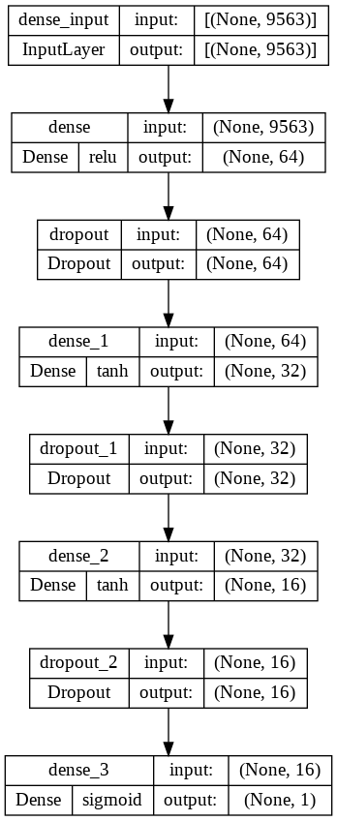
ANN For Binary Class Classification
Number of layers: 7
Loss function used: Binary Cross Entropy
Optimizer: RMSProp
Total number of trainable parameters: 614,721

Slide 12
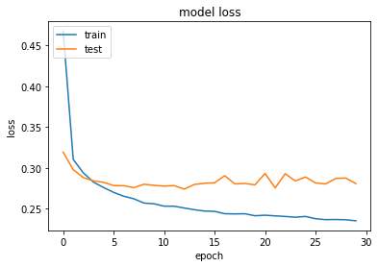
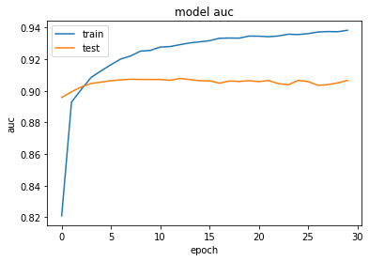
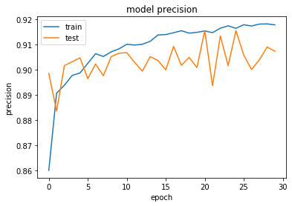
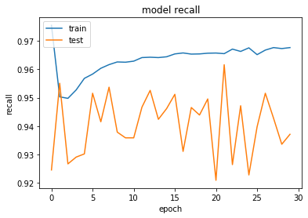

Slide 13
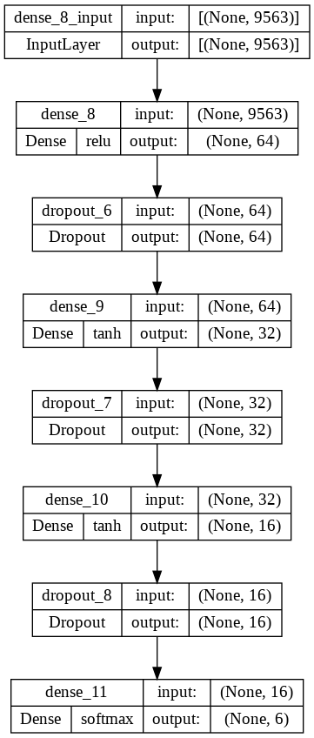
ANN For Multi Class Classification
Number of layers: 7​
​
Loss function used: Categorical Cross Entropy​
​
Optimizer: Adam
​
Total number of trainable parameters: 614,806

Slide 14
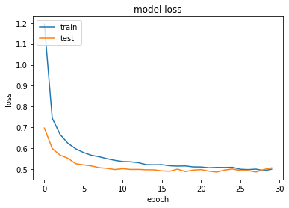
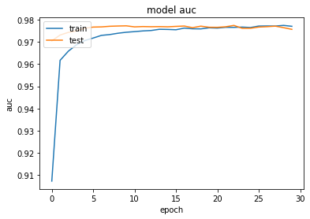
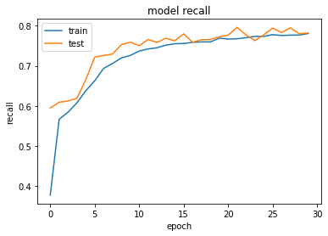
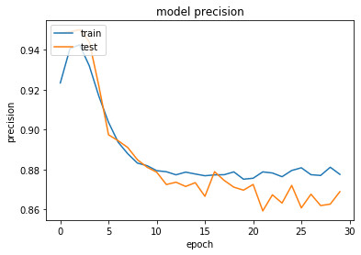

Slide 15
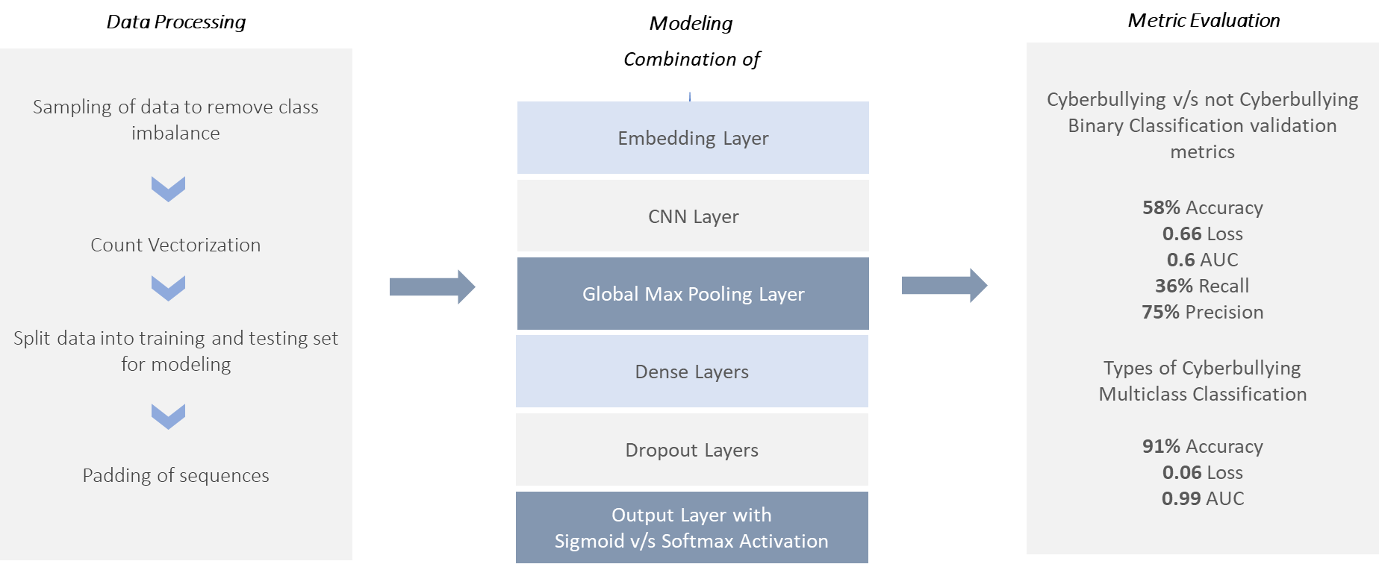
Convolutional Neural Network
A CNN Model usually involves a Convolution and a Pooling layer that are connected hence to a fully connected layer (herein a dense layer) - the convolutions can be looked at as a transformation operation on the CV matrix per region whereas the pooling layer pools each convoluted object to identify distinctive representative features

Slide 16

Recurrent Neural Network
An RNN Model usually has a short-term memory saved for past incidences that are weighted and used for future predictions leading to successful use cases associated with classification

Slide 17
RESULTS: Two-Class Text Classification
Binary Classification | val_auc_1 | val_binary_accuracy | val_recall | val_precision
Naïve Bayes | 0.886 | 0.83 | 0.793 | 0.81
ANN | 0.9046 | 0.8650 | 0.9298 | 0.9101
CNN | 0.6 | 0.58 | 0.36 | 0.75
RNN | 0.49 | 0.49 | 1.00 | 0.51

Slide 18
RESULTS: Multi-Class Text Classification
Multi-Class Classification | val_auc_1 | val_multiclass_accuracy | val_recall | val_precision
Naïve Bayes | 0.982 | 0.85 | 0.84 | 0.858
ANN | 0.9754 | 0.8279 | 0.7475 | 0.8798
CNN | 0.99 | 0.91 | - | -
RNN | 0.50 | 0.20 | - | -

Slide 19
Final Model Evaluation
Binary Classification
Cyberbullying v/s Not Cyberbullying
Best Model: ANN Model
With
87%
Accuracy
Multiclass Classification
Types of Cyberbullying
Best Model: CNN Model
With
91%
Accuracy

Slide 20
FUTURE WORK
We can experiment with other available datasets from either twitter or other social media apps, such as instagram, facebook, and tiktok.
We could run a multi-class classification task on a dataset for different social media apps with our best model, then evaluate which social media site has the highest rates of cyberbullying within the subcategories.
We intended to include a GCN model implementation in our work, but this requires DQE data created separately which we did not have access to.
Additional models we can test include Random Forest and KNN.

Slide 21
Thank you
Presentation by Group 10

